Slide 1
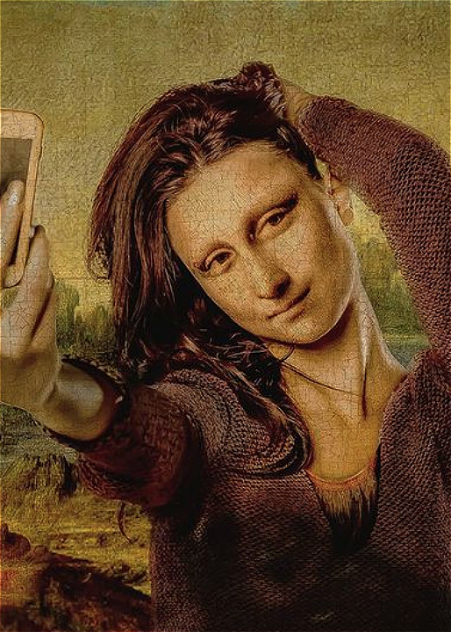

SUPER RESULOTION
Group 9
Li, Yiwei (yl3950)
Wu, Qianqian (qw2284)
Xia, Xin (xx2295)
Yin, Chao (cy2507)
Zhang, Yun (yz3384)

Slide 2
INDEX
Project Goal
Baseline Model
Advanced Model
Improvement

Slide 3
PROJECT GOAL
Produce a predicted high resolution image as output based on the blurry and low-resolution input.
01
02
Accuracy
Efficiency
PNSR
Running Time

Slide 4
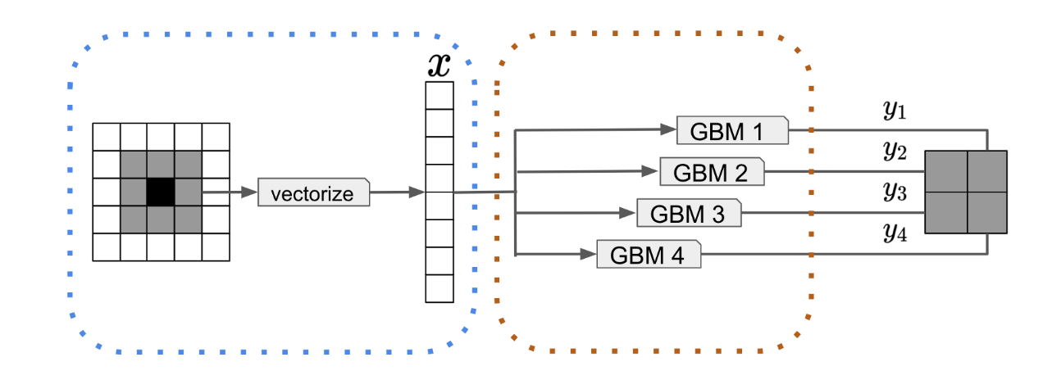
BASELINE MODEL
GBM
Feature Construction
Patch-based algorithm, random sample

Slide 5
BASELINE MODEL
Feature Extraction
GBM
0.0001
0.001
N.trees = 1000
Depth = c(3, 6, 9, 12, 15)
K = 10
Learning rate = c(0.1, 0.01, 0.001, 0.0001)
0.1
0.01

Slide 6
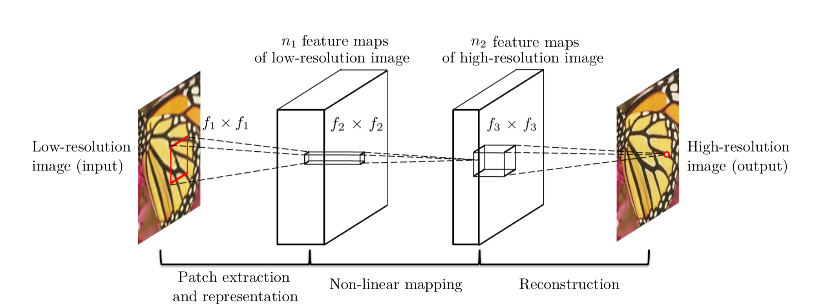
ADVANCED MODEL
SRCNN

Slide 7
ADVANCED MODEL
Random Crop =30
Patch size = 33
Adam Learning Rate = 0.0003
Validation Split = 0.2
Epoch = 100
Batch = 128
SRCNN
Color Chanel | Training |  | Validation
 | MSE | PSNR | MSE | PSNR
RGB | 0.003 | 26.103 | 0.004 | 23.859
Y | 0.002 | 26.771 | 0.004 | 24.541
YCrCb | 0.001 | 30.597 | 0.001 | 28.435

Slide 8
IMPROVEMENT
Category | Type | GBM | SRCNN | Improved %
Time | Feature construction | 51.77 | 25.71 | 50%
 | Model Training | 2839.15 | 528.71 | 81%
 | In Class Testing
Accuracy | MSE | 0.003 | 0.001 | 64%
 | PSNR | 25.576 | 30.063 | 18%
Further Potential Improvement…
Baseline: Increase number of points and features…
Advanced: Increase number of patches, layers and epoch…

Slide 9
IMPROVEMENT
GBM
Original
SRCNN

Slide 10
THE END
Thank you!
2019
3.27

